Slide 1

Easy I-Management System
Yat Wai Keong

Slide 2
EASY I-Management System
Aware the Stock Quantity
Manage and Store

Slide 3
Easy I-Management System
Tools
Microsoft Visual Studio
Microsoft SQL Server Management Studio 18
Application
ASP.NET Web Application (Model-View-Controller)
Database
SQL Server

Slide 4
Inventory Management System
Front end & back end
Front End
ASP.NET Web Application (Model-View-Controller
CSS
Back End
ADO.NET Entity Framework
SQL Database

Slide 5
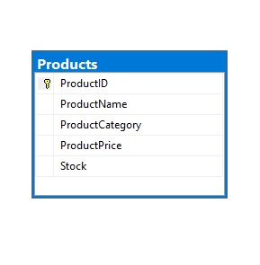
Entity Relationship Diagram (ERD)
Entities
Products

Slide 6
LogIn
LogOut
Details
SignUp
Edit
Delete
Moduls

Slide 7
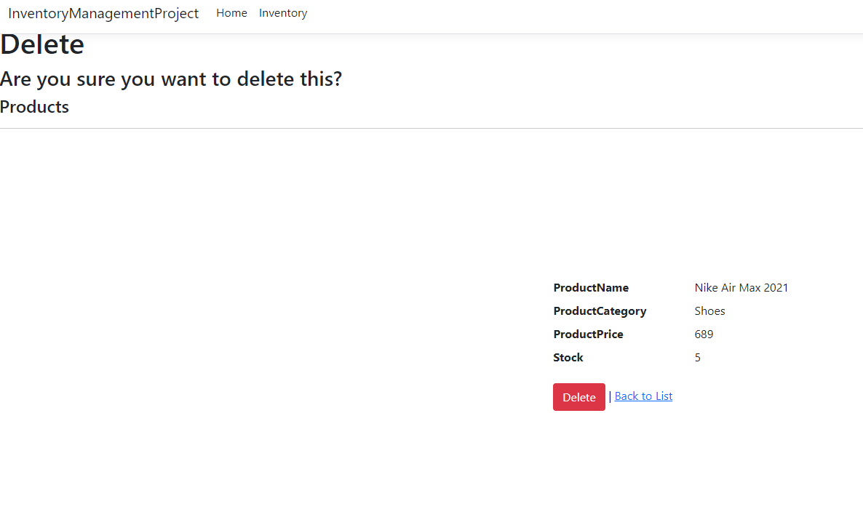
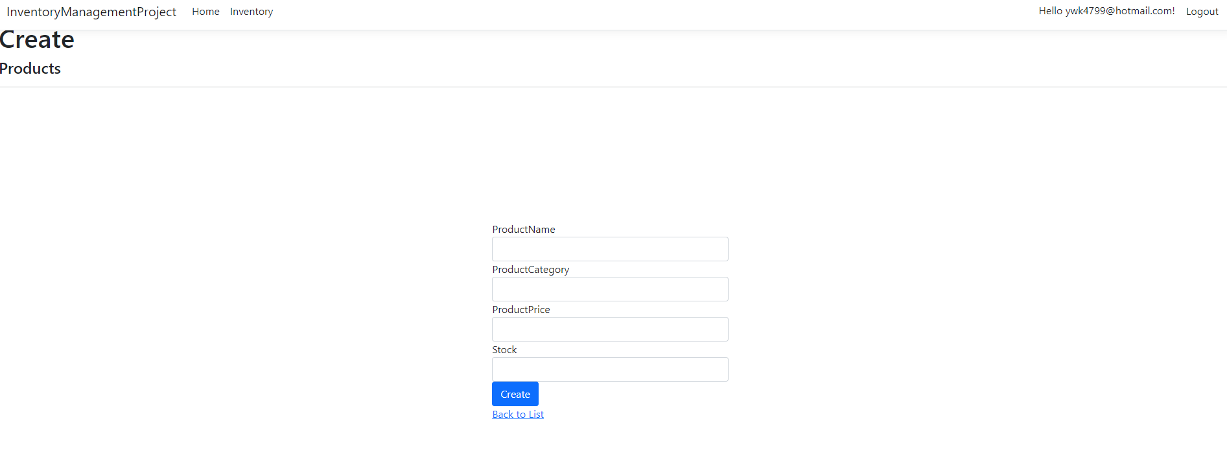

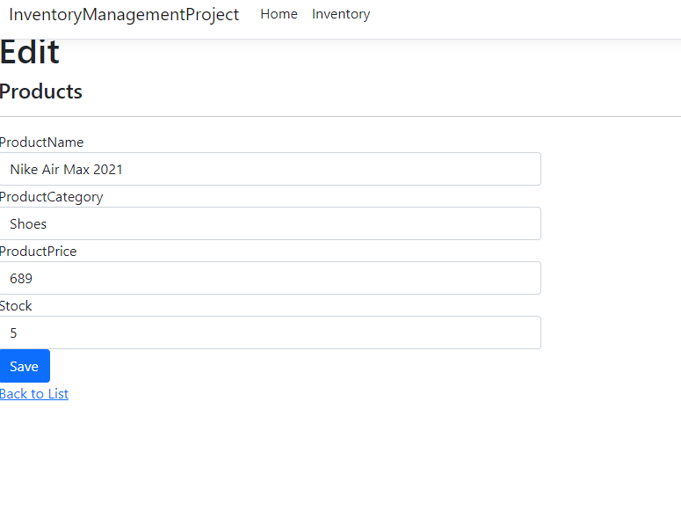
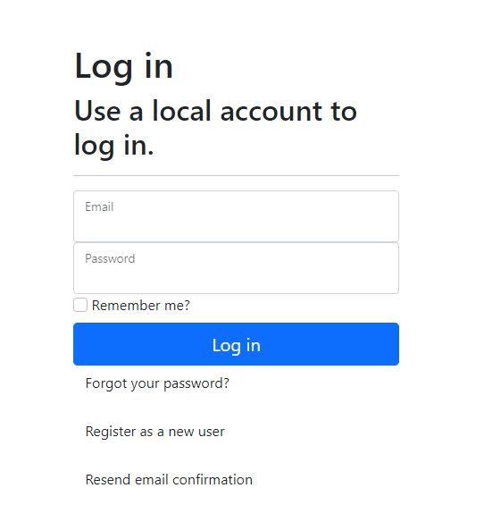
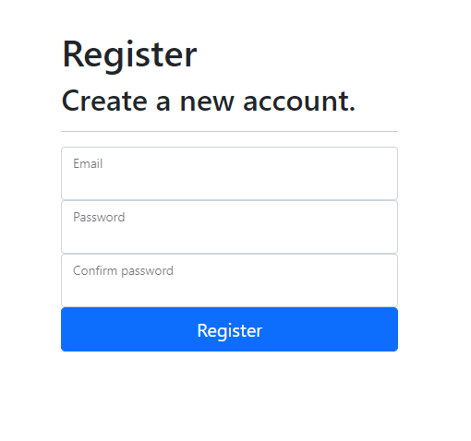
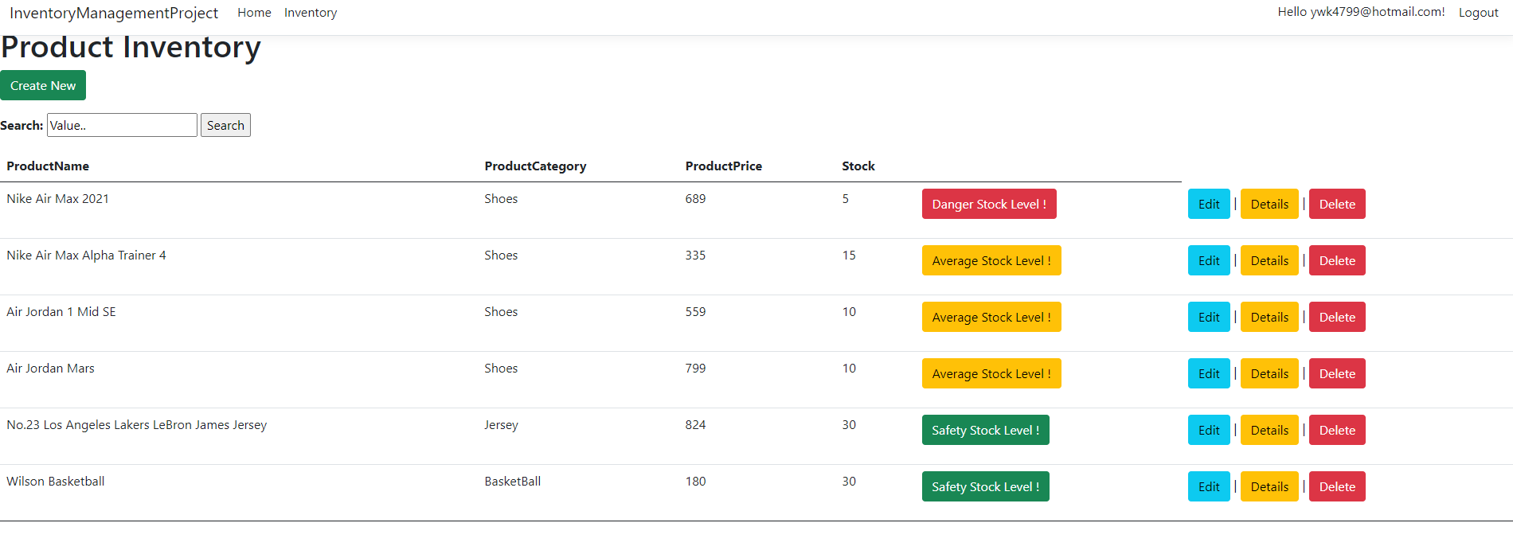
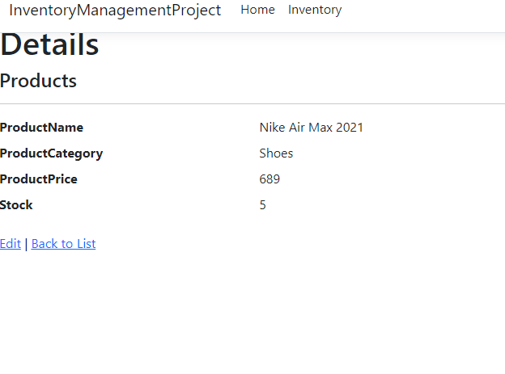
Pages
Home Page
Register Page
Login Page
Inventory Page
Details Page
Edit Page
Delete Page

Slide 8
Thank You!!!

